Slide 1
INTE 22283 – Mobile Application Development
Week 1: Introduction to Mobile Computing and Mobile Networks
Sammani Maddumahewage
Lecturer (Probationary)
BSc (Hons) in Information Technology

Slide 2
Course Learning Outcomes (CLOs)
CLO 1: Explain fundamental concepts of mobile computing, mobile networks, and major mobile OS architectures
CLO 2: Compare native, hybrid, and cross-platform development approaches and select an appropriate platform
CLO 3: Design user interfaces and user-flow prototypes applying UI/UX principles and navigation patterns
CLO 4: Develop, debug, and test mobile applications integrating web services, sensors, and databases
CLO 5: Implement security and privacy mechanisms including secure storage, authentication, and permissions
CLO 6: Integrate mobile applications with IoT devices and evaluate deployment/monetization strategies

Slide 3
Today's Learning Outcomes
Define mobile computing and identify its core characteristics
Trace the evolution of mobile networks from 1G to 5G
Explain cellular network architecture and mobility management
Describe handoff, roaming, and location management concepts
Differentiate mobile computing, wireless computing, and ubiquitous computing
Identify the building blocks of the mobile application ecosystem
Discuss current trends and industry relevance of mobile app development
Outline module structure, assessment plan, and practical lab expectations

Slide 4
Why This Topic Matters
Ubiquity: Over 7.2 billion smartphone subscriptions exist worldwide — mobile is the primary computing platform for most of humanity
Economic scale: The global mobile app economy generates hundreds of billions of dollars annually through app stores, advertising, and services
Foundation for the module: Every later topic — OS architecture, UI design, APIs, security, IoT — builds on the networking and platform concepts introduced today
Career relevance: Mobile development is one of the most in-demand software engineering specializations in the current job market

Slide 5
What Is Mobile Computing?
Definition: Mobile computing is a technology paradigm that allows transmission of data, voice, and video via a computer or any other wireless-enabled device, without being connected to a fixed physical link
Key idea: The computing device and the user are free to move while remaining connected to a network and to data
Distinguishing factor: Unlike traditional desktop computing, mobile computing assumes the device's location, connectivity, and available resources can change at any time

Slide 6
Core Characteristics of Mobile Computing
Portability
Devices are small, lightweight, and battery-powered for movement
Connectivity
Continuous or intermittent access to wireless networks (cellular, Wi-Fi, Bluetooth)
Interactivity
Real-time, two-way communication between user, device, and remote services
Individuality
Devices are typically personalized to a single user's preferences, identity, and context
Context-awareness
Applications can sense and respond to location, motion, time, and environment

Slide 7
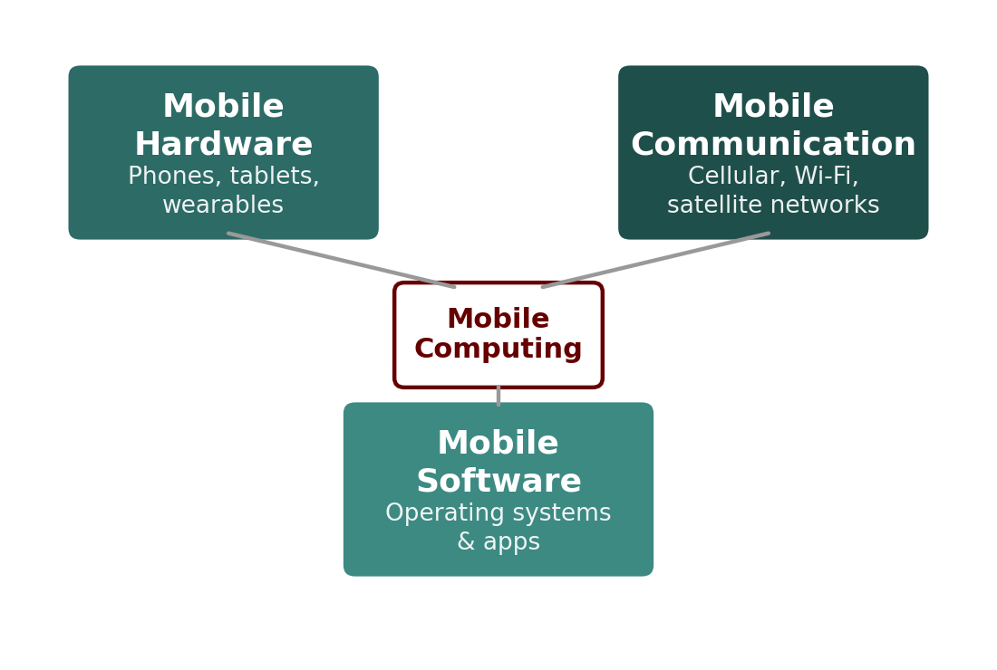
Components of a Mobile Computing System
[ INSERT IMAGE ]
Mobile hardware: Smartphones, tablets, wearables — devices with processors, sensors, and radios
Mobile software: Operating systems and applications designed for constrained, portable hardware
Mobile communication: The wireless infrastructure (cellular networks, Wi-Fi, satellite) that carries data between devices and servers
Figure 1: The three core components that together enable mobile computing

Slide 8
The Generations of Mobile Networks
1G (1980s): Analog voice-only cellular networks; no data capability; poor security and call quality
2G (1990s): Digital voice and basic text messaging (SMS); introduced GSM standard and circuit-switched data
3G (2000s): Packet-switched data enabling mobile internet, video calls, and early smartphones (up to ~2 Mbps)
4G / LTE (2010s): All-IP network design; high-speed mobile broadband (up to ~100 Mbps+) enabling app ecosystems, streaming, and cloud services
5G (2020s–present): Ultra-low latency, massive device density, and multi-Gbps speeds enabling IoT at scale, AR/VR, and real-time applications

Slide 9
Comparing Network Generations
Table 1: Key technical characteristics across mobile network generations
Generation | Era | Peak Speed | Key Capability
1G | 1980s | 2 kbps | Analog voice calls
2G | 1990s | 64 kbps | Digital voice + SMS
3G | 2000s | ~2 Mbps | Mobile internet, video calls
4G / LTE | 2010s | ~100+ Mbps | Mobile broadband, app ecosystems
5G | 2020s | Multi-Gbps | IoT scale, ultra-low latency

Slide 10
Why Network Generation Matters for App Developers
Bandwidth assumptions: Apps must work gracefully across variable network speeds — from poor 3G coverage to 5G
Latency-sensitive features: Real-time apps (gaming, video calls, AR) depend on the low-latency characteristics 5G provides
Offline-first design: Because network quality is never guaranteed, well-designed apps cache data and degrade gracefully when connectivity drops
IoT enablement: 5G's device density support is what makes large-scale IoT integration — a topic in Week 15 — practical

Slide 11
Cellular Network Architecture
Core Components
Why Cells Exist
Cell: A geographic area served by one base station
Base Station (BTS/eNodeB): Transmits/receives radio signals to/from devices in its cell
Mobile Switching Center (MSC): Routes calls and data between cells and the wider network
Frequency reuse: Dividing coverage into small cells lets the same frequencies be reused in non-adjacent cells
Capacity scaling: Smaller cells support more simultaneous users in dense areas
Coverage efficiency: Lower transmission power per cell reduces interference and battery drain

Slide 12
Mobility Management
Definition: The set of network functions that track a mobile device's location and maintain connectivity as the device moves
Location management: The network continuously registers which cell (or area) a device is currently in, so incoming calls/data can be routed correctly
Handoff management: The network transfers an active connection from one cell to another as a device moves, ideally without the user noticing
Why it's hard: Mobility management must operate in real time, at scale, while conserving device battery and network signaling capacity

Slide 13
Handoff (Handover): Keeping Connections Alive
Definition
The process of transferring an active call or data session from one base station to another as a device moves between cells
Hard handoff
Connection to the old cell is dropped before the new one is established (used in older/2G-style systems)
Soft handoff
Device briefly maintains connections to both cells during transition, reducing the risk of dropped calls (used in 3G/4G/5G)
Why it matters for apps
A poorly designed app can interpret a brief handoff delay as a network failure and behave incorrectly — robust apps tolerate short interruptions

Slide 14
Roaming
Definition: The ability of a mobile device to remain connected and usable when it moves outside its home network's coverage area, by using another provider's network
National roaming: Using a different network within the same country, typically due to coverage gaps
International roaming: Using a foreign carrier's network when traveling abroad, governed by agreements between operators
Practical implication: Roaming often introduces higher latency, different bandwidth characteristics, and sometimes additional cost — all relevant when designing data-conscious mobile apps

Slide 15
Mobile vs. Wireless vs. Ubiquitous Computing
Table 2: These terms are related but not interchangeable
Term | Core Idea | Example
Mobile computing | Computing that moves with the user | Using a smartphone app on a train
Wireless computing | Computing connected without physical cables | A desktop PC on Wi-Fi (not portable)
Ubiquitous computing | Computing embedded invisibly into everyday environments | Smart home sensors, wearables, ambient displays

Slide 16
Clarifying the Distinctions
Mobile computing requires portability: the device itself must be able to move with the user; this is the defining trait
Wireless computing only requires absence of cables: a stationary device on Wi-Fi is wireless but not mobile
Ubiquitous computing (“pervasive computing”) goes further: computing power is distributed invisibly throughout the environment, not concentrated in one personal device
Overlap: Most modern mobile computing is also wireless, and increasingly intersects with ubiquitous computing through IoT — the convergence point we revisit in Week 15

Slide 17
The Mobile Application Ecosystem
Devices
Smartphones, tablets, wearables — the hardware running the OS and apps
Networks
Cellular and Wi-Fi infrastructure that connects devices to back-end services
Platforms
Operating systems (Android, iOS) and their SDKs that define how apps are built and run
App stores
Distribution channels (Google Play, Apple App Store) that handle discovery, installation, and monetization
Back-end services
Cloud APIs, databases, and authentication services that most non-trivial apps depend on

Slide 18
How the Ecosystem Pieces Connect
Developer's View
User's View
Build for a platform: Choose Android, iOS, or cross-platform tools
Use device capabilities: Sensors, camera, GPS, storage
Connect to services: REST APIs, cloud databases (Weeks 7–10)
Discover: Find the app through an app store or web link
Install: Download and grant permissions
Use: Interact with the app over a network connection, often intermittently

Slide 19
Worked Example: A Ride-Hailing App
Mobile computing in action: The rider's and driver's phones move continuously while staying connected
Network generation dependency: Real-time location updates and matching require low-latency 4G/5G connectivity; performance degrades visibly on 2G/3G
Handoff in practice: A ride across a city involves dozens of handoffs between cells — the app must tolerate brief signal gaps without crashing or losing trip state
Ecosystem touchpoints: The app depends on GPS (device), cellular data (network), the Android/iOS platform (OS), and cloud APIs (back end) simultaneously

Slide 20
Worked Example: Cross-Border Travel
Scenario: A user crosses a national border with their phone powered on and connected
Roaming triggered: The device's home network has no coverage, so it negotiates access to a partner network in the new country (international roaming)
Mobility management at play: Location management must update the network on the new country's infrastructure; handoff occurs continuously as the user moves
Design implication: A well-built travel or messaging app should detect roaming conditions and adapt — for example, warning the user about data costs or switching to a lower-bandwidth mode

Slide 21
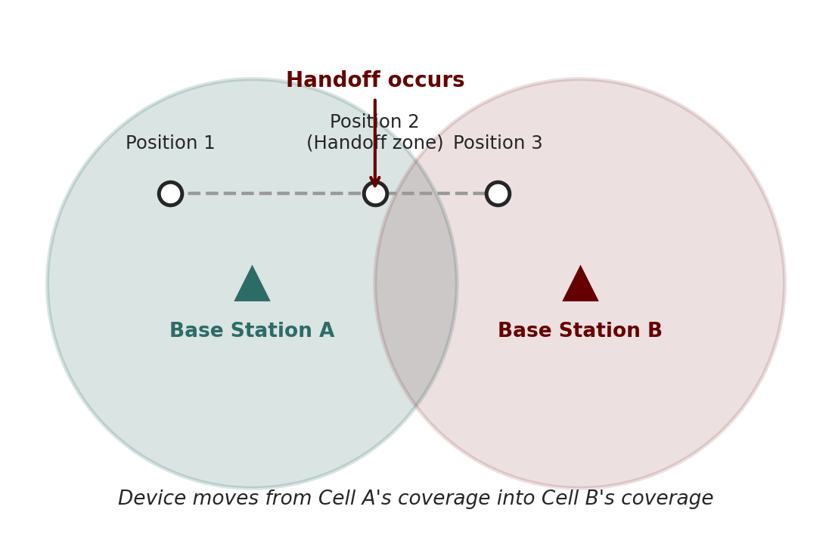
Cellular Handoff Illustrated
[ INSERT IMAGE ]
Step 1: Device is connected to Base Station A; signal strength is strong
Step 2: As the device moves, signal from Base Station B becomes stronger than A
Step 3: The network initiates handoff, establishing a connection to B
Step 4: Connection to A is released once B is confirmed active (soft handoff)
Figure 2: As a device moves from Cell A to Cell B, the network transfers the active connection between base stations

Slide 22
Current Trends in Mobile Application Development
Cross-platform frameworks: Flutter and React Native continue to reduce the cost of supporting both Android and iOS from one codebase (explored in Week 3 and Week 12)
5G-enabled experiences: Augmented reality, cloud gaming, and real-time collaboration apps are increasingly viable as 5G rolls out globally
On-device AI: Machine learning models increasingly run directly on mobile hardware rather than purely in the cloud, improving privacy and responsiveness
Privacy-first design: App stores and regulators (e.g., GDPR) are tightening requirements on data collection, consent, and permission transparency
IoT convergence: Mobile apps increasingly serve as the primary control interface for connected devices — the subject of Week 15

Slide 23
Why This Matters for Your Career
High demand: Mobile developers remain among the most sought-after software engineering roles globally
Broad applicability: Skills learned in this module — UI/UX, APIs, databases, security — transfer directly to web and backend development as well
Entrepreneurial pathway: Low barrier to publishing (app stores) makes mobile development a common route into independent software products
This module's design: Each week builds toward Assignment 2 — a complete, deployable mobile application — mirroring how real development teams work

Slide 24
Assessment Plan Overview
Table 3: How your performance in this module will be evaluated
Component | Type | Weight
Assignment 1 | Individual | 10%
Assignment 2 | Group Project | 30%
Final Examination | Individual | 60%

Slide 25
Module Structure and Practical Expectations
Format: 2 hours of lecture plus 3 hours of practical lab work each week, for 15 weeks
Lectures: Build conceptual understanding — architecture, design principles, security models
Practical labs: Apply that week's concepts hands-on, building toward the skills needed for Assignment 2
Assignment 1 (10%): An individual exercise on a single app component (UI screen, API integration, or sensor feature)
Assignment 2 (30%): A group project building a complete app integrating an API, a database, and a security mechanism
Final Examination (60%): Written assessment covering theoretical understanding and applied problem-solving across the whole module

Slide 26
Key Takeaways
Mobile computing is defined by portability, connectivity, interactivity, individuality, and context-awareness
Mobile networks evolved from analog voice-only (1G) to multi-Gbps, IoT-scale infrastructure (5G)
Cellular architecture relies on cell-based frequency reuse, with handoff and roaming maintaining connectivity as devices move
Mobile, wireless, and ubiquitous computing are related but distinct concepts — portability is mobile computing's defining trait
The mobile app ecosystem spans devices, networks, platforms, app stores, and back-end services working together

Slide 27
Summary
This week established the foundational vocabulary and concepts for the entire module: what mobile computing is, how mobile networks have evolved, and how cellular networks keep moving devices connected.
We distinguished mobile computing from related but different concepts — wireless and ubiquitous computing — and mapped out the ecosystem of devices, networks, platforms, and services that any mobile app depends on.
These concepts directly underpin next week's topic: the architecture of mobile operating systems themselves.

Slide 28
Discussion Questions
Think of a mobile app you use daily. Which of the five core characteristics of mobile computing (portability, connectivity, interactivity, individuality, context-awareness) does it rely on most heavily, and why?
Why might an app that works perfectly on 5G fail or frustrate users on a 3G connection? What design choices could mitigate this?
Is a smart speaker (e.g., a voice assistant device) an example of mobile computing, wireless computing, or ubiquitous computing? Justify your answer.
Which part of the mobile app ecosystem (devices, networks, platforms, app stores, back-end services) do you think presents the biggest challenge for a new developer, and why?

Slide 29
Thank You !
Questions?
Email: Sammani@kln.ac.lk | Department of Industrial Management

